Slide 1
Adding Conditional Control to Text-to-Image Diffusion Models
Lvmin Zhang, Anyi Rao, Maneesh Agrawala, “Adding Conditional Control to Text-to-Image Diffusion Models”, in Proc. the IEEE/CVF Conference on Computer Vision and Pattern Recognition (CVPR), 2024. Available: https://arxiv.org/abs/2302.05543
2025-04-10
Sein Choi
Intelligent Vision Processing Lab. (IVPL)
https://ivpl.sookmyung.ac.kr
Div. of AI Engineering, Sookmyung Women’s University
E-mail: csi1806@sookmyung.ac.kr

Slide 2
No. | Title | Keyword | Cite
1 | Learning Transferable Visual Models From Natural Language Supervision | Contrastive Learning, Multimodal Representation | Alec Radford, Jong Wook Kim. (2021). Learning Transferable Visual Models From Natural Language Supervision, In Proc. of the 38th International Conference on Machine Learning, pages 8748–8763. PMLR. [Online]. Available: https://arxiv.org/abs/2103.00020
2 | GLIDE: Towards photorealistic image generation and editing with text-guided diffusion models | Text-to-Image Generation, Diffusion Models, guided image synthesis | A Nichol, P. Dhariwal, A. Ramesh. “GLIDE: Towards photorealistic image generation and editing with text-guided diffusion models”, In Proc. of the 39th International Conference on Machine Learning, 2022, pp. 16907-16921. Available: https://arxiv.org/abs/2112.10741
3 | Hierarchical Text-Conditional Image Generation with CLIP Latents | Text-to-Image Generation, CLIP Latents, unCLIP, Diffusion Models | Ramesh A, Dhariwal P, Nichol A, Chu C, Chen M., “Hierarchical Text-Conditional Image Generation with CLIP Latents”, 2022, Available: https://arxiv.org/abs/2112.10741
4 | High-Resolution Image Synthesis with Latent Diffusion Models | Text-to-Image Generation, VAE, Diffusion Models, Cross-Attention | Rombach, R., Blattmann, A., Lorenz, D., Esser, P., & Ommer, B.,"High-Resolution Image Synthesis with Latent Diffusion Models," in Proc. the IEEE/CVF Conference on Computer Vision and Pattern Recognition (CVPR), 2022. Available: https://arxiv.org/abs/2112.10752
5 | SDXL: Improving Latent Diffusion Models for High-Resolution Image Synthesis | LDM | D. Podell, Z. English, K. Lacey, A. Blattmann, T. Dockhorn, J. Müller, J. Penna, and R. Rombach, "SDXL: Improving Latent Diffusion Models for High-Resolution Image Synthesis,“, in Proc. the IEEE/CVF Conference on Computer Vision and Pattern Recognition (CVPR), 2023. Available: https://arxiv.org/abs/2307.01952.
6 | Adding Conditional Control to Text-to-Image Diffusion Models | Stable Diffusion, zero convolution, trainable copy | Lvmin Zhang, Anyi Rao, Maneesh Agrawala, “Adding Conditional Control to Text-to-Image Diffusion Models”, in Proc. the IEEE/CVF Conference on Computer Vision and Pattern Recognition (CVPR), 2024. Available: https://arxiv.org/abs/2302.05543

Slide 3
Contents
Zero Convolution
How Zero-Convolution Trained?
Experiment Setting
Weight, Bias Output

Slide 4
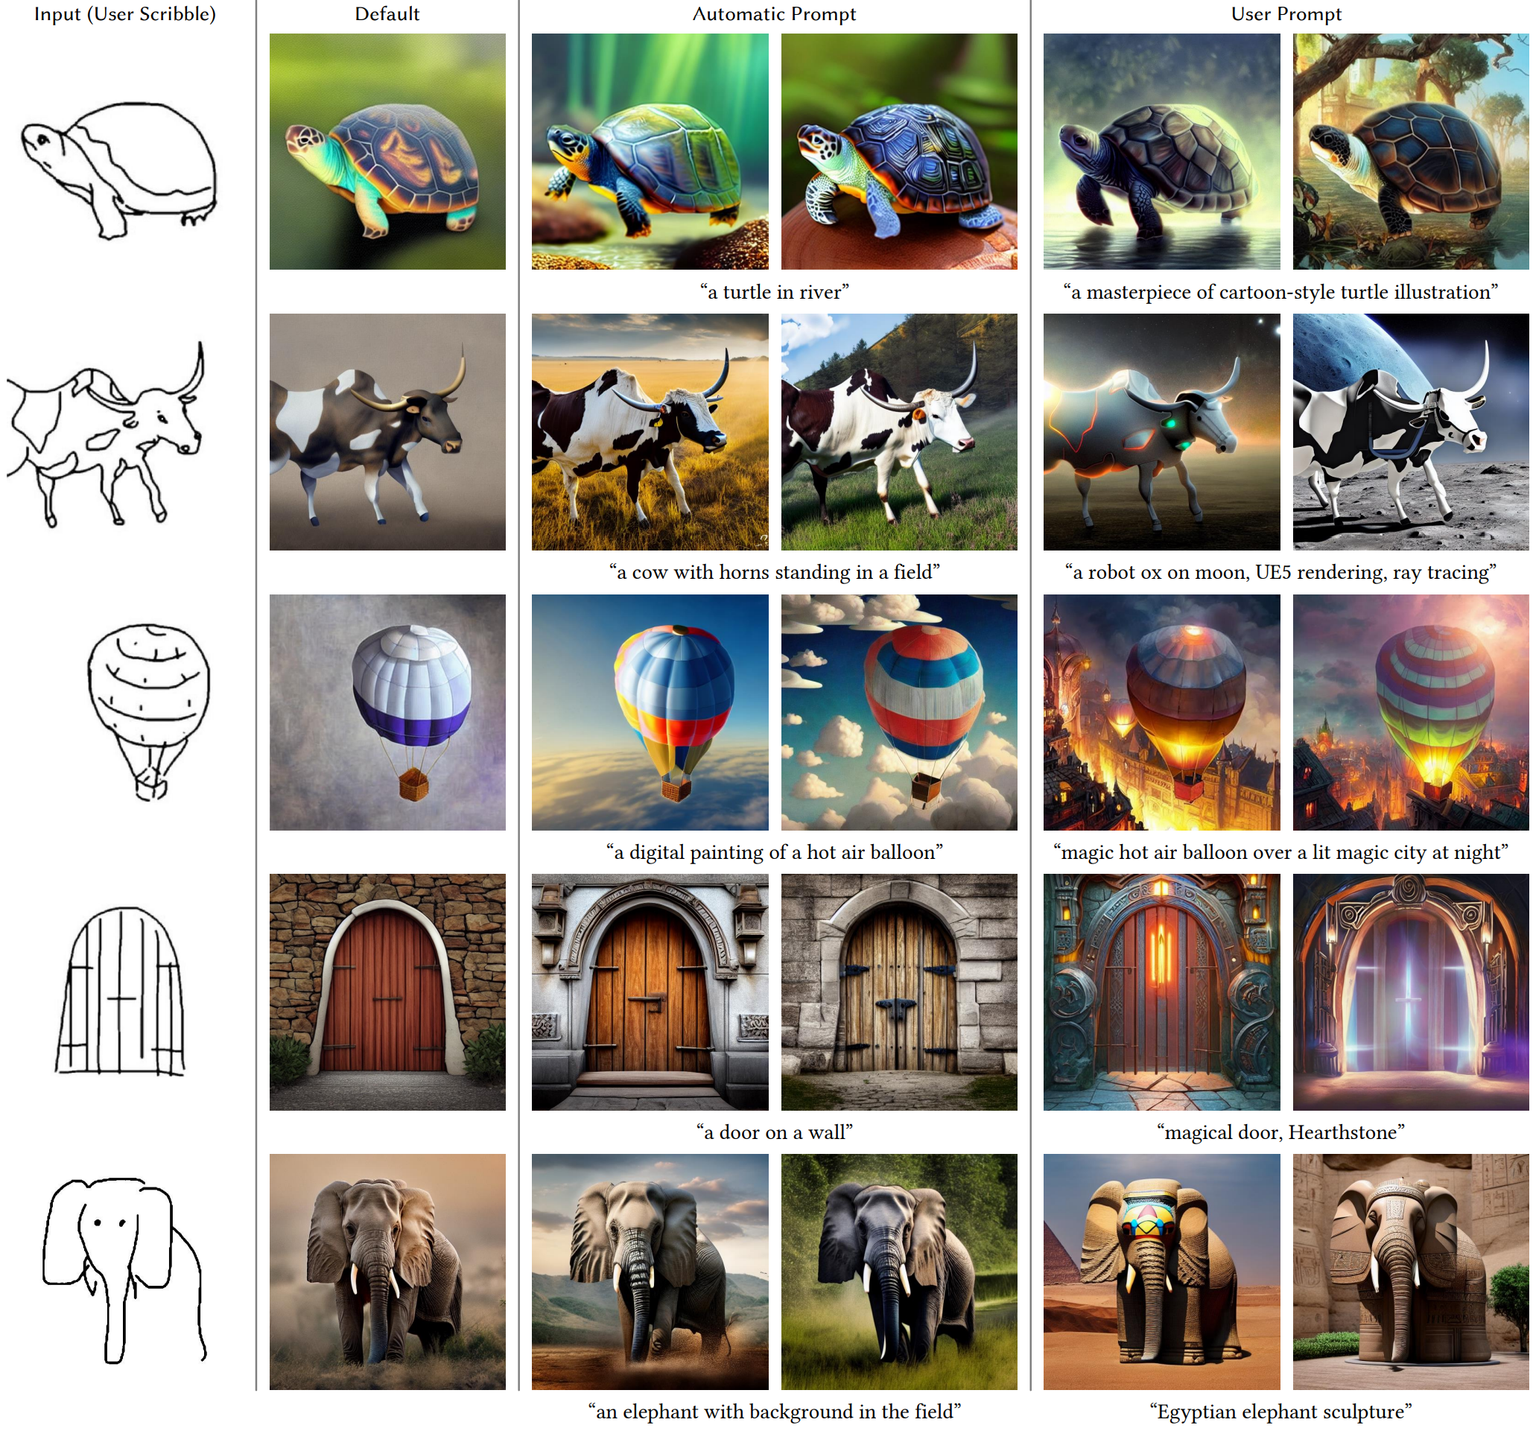
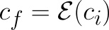
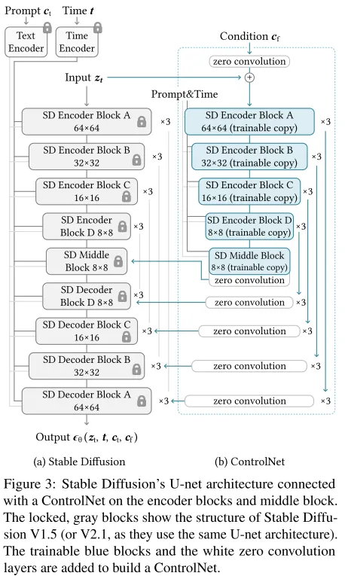
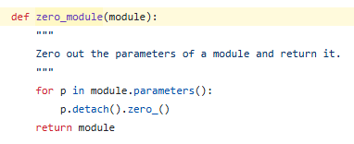
Zero-Convolution
positional encoding
Zero-Convolution
“The "zero convolution" is 1×1 convolution with both weight and bias initialized as zeros.”
Code
OenAI CLIP
512x512
64x64 feature map
(4 ResNet + 2 ViTs)
Notes:
detach() : backprop 계산하지 않음, 연산 그래프 분리해서 초기 출력이 기존 SD 모델에 영향 미치지 않게 함
zero_() : 값을 0으로 만들어주는 함수 , _가 붙어서 inplace 연산을 나타냄(기존 텐서를 수정)

Slide 5
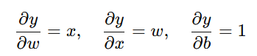
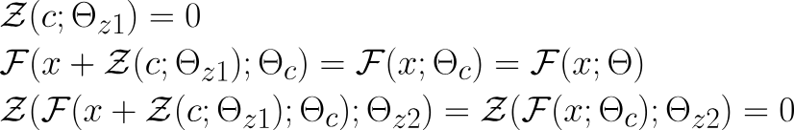
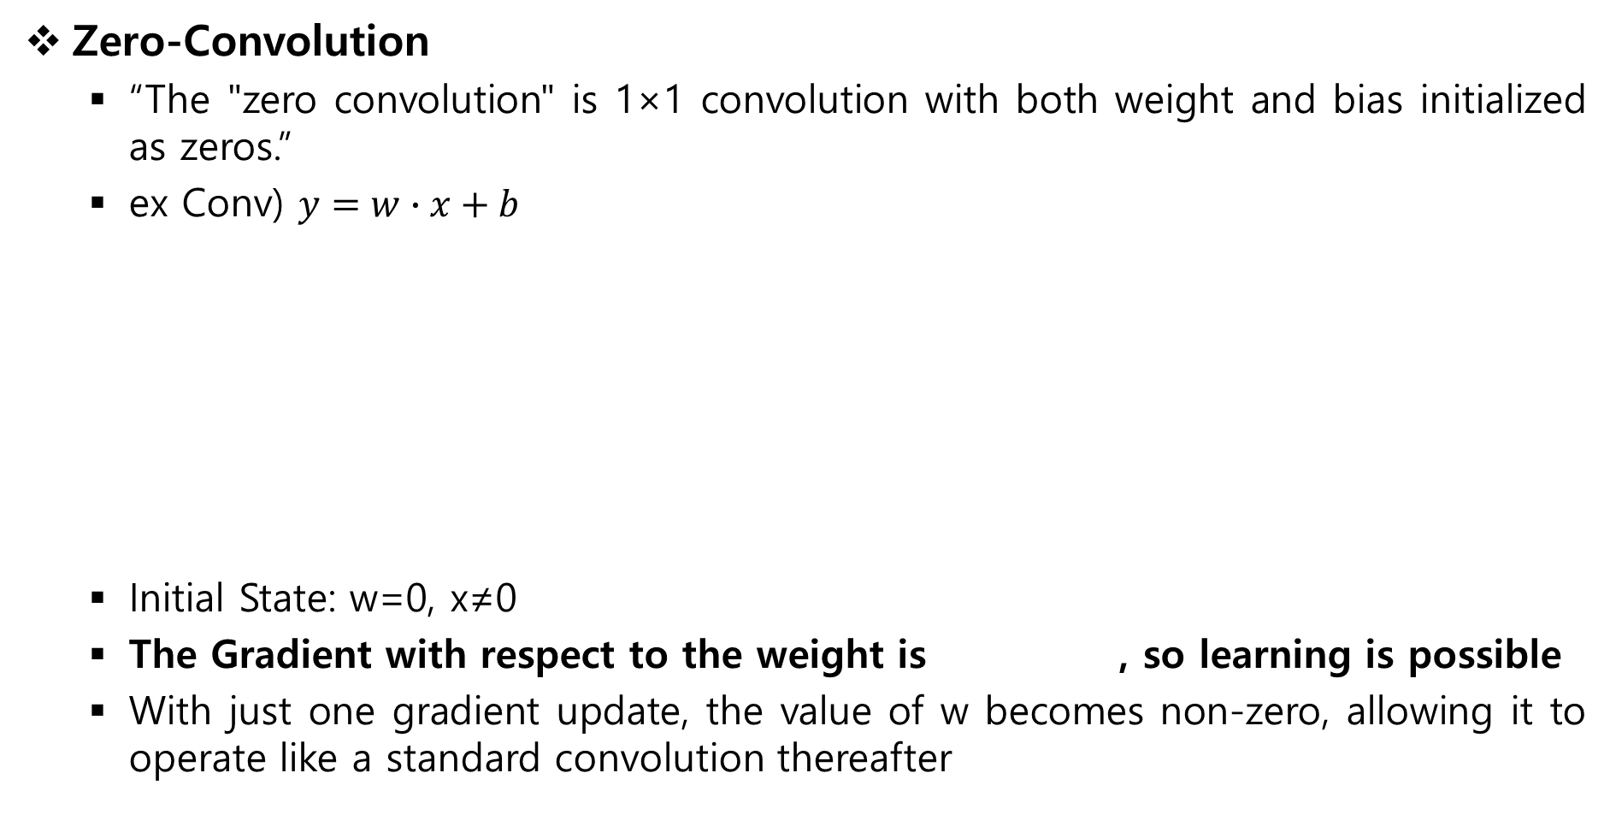
Zero-Convolution
Zero-Convolution
“The "zero convolution" is 1×1 convolution with both weight and bias initialized as zeros.”
ex Conv) $y=w∙x+b$
Initial State: w=0, x≠0
The Gradient with respect to the weight is , so learning is possible
With just one gradient update, the value of w becomes non-zero, allowing it to operate like a standard convolution thereafter
partial derivative

Slide 6
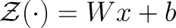
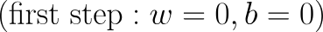
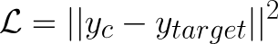
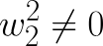
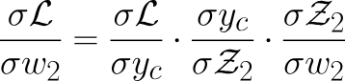
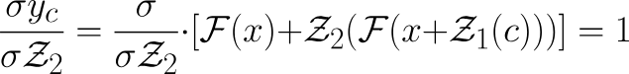
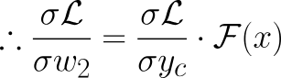
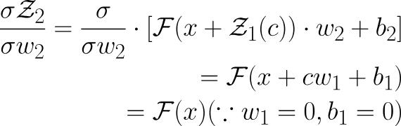
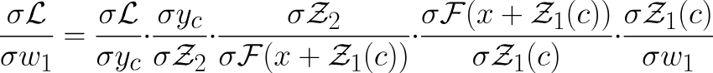
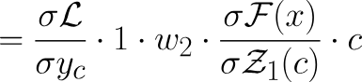
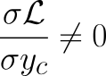
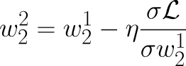
How Zero-Convolution Trained?
Simple Format
zero-convolution
Assume Loss Function : MSE
w2 gradient
w1 gradient
Since
(2)
(1)
(2)
(3)
(3)
(1)
(3)
First step
Second Step

Slide 7
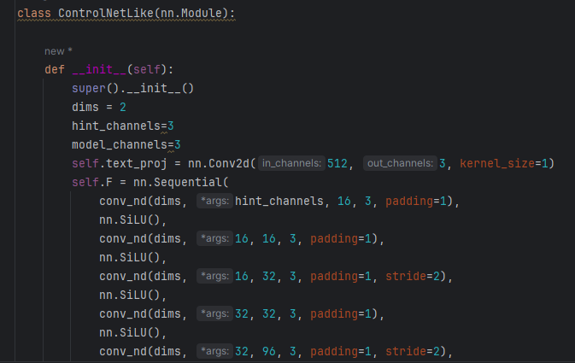
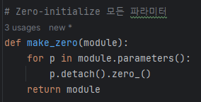
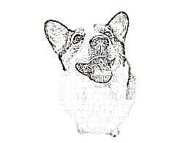
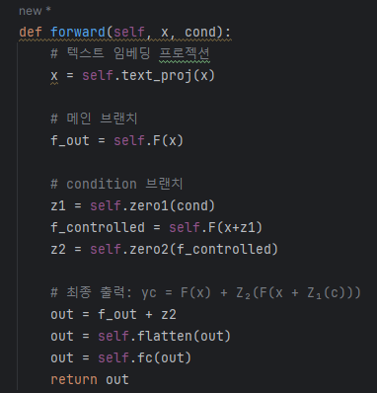
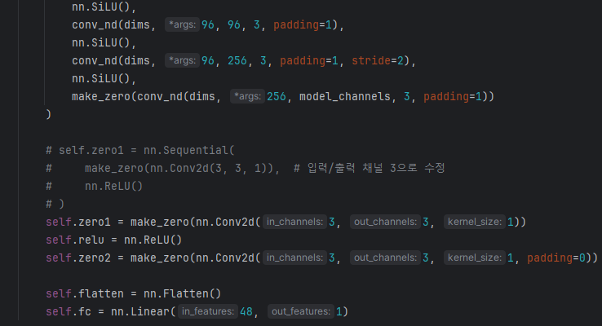
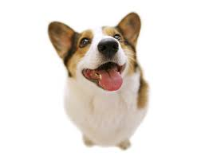
Experiment Setting
Text : x (“dog”)
Condition : cond (edge)
Target : (dog image)
Loss func : MSE
Notes:
코드로 구현하면 cond랑 target이랑 달라서 loss가 처음부터 생김..............

Slide 8
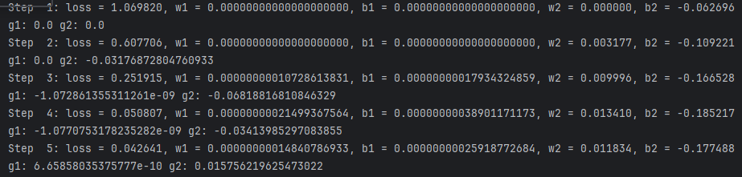
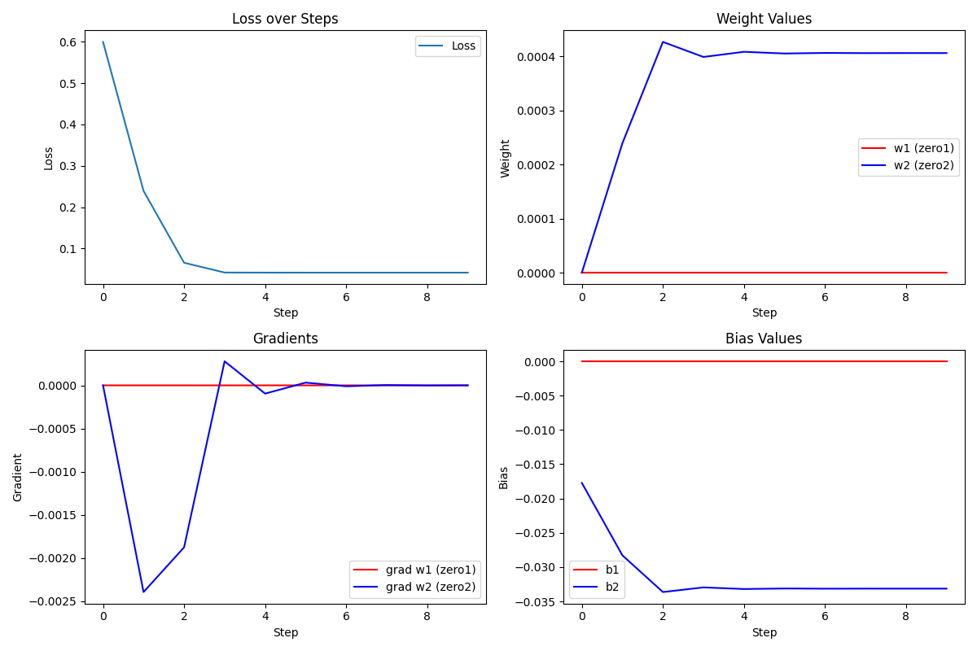
Weight, Bias Output
Notes:
w1, b1은 매우 작은 값이어서 그래프에서 일직선으로 나타나나 숫자로 뽑아보면 값 있음을 확인.

Slide 9
Thank you for your attention.!!!
QnA

